Slide 1
Watershed restoration and protection strategy
Chris zadak and Rachel olmanson, Metr0-st. croix watershed unit

Slide 2
What is a “wraps”?
Clean Water Legacy Act:
Subd. 13. Watershed restoration and protection strategy or WRAPS. "Watershed restoration and protection strategy" or "WRAPS" means a document summarizing scientific studies of a major watershed no larger than a hydrologic unit code 8 including the physical, chemical, and biological assessment of the water quality of the watershed; identification of impairments and water bodies in need of protection; identification of biotic stressors and sources of pollution, both point and nonpoint; TMDL's for the impairments; and an implementation table containing strategies and actions designed to achieve and maintain water quality standards and goals.

Slide 3
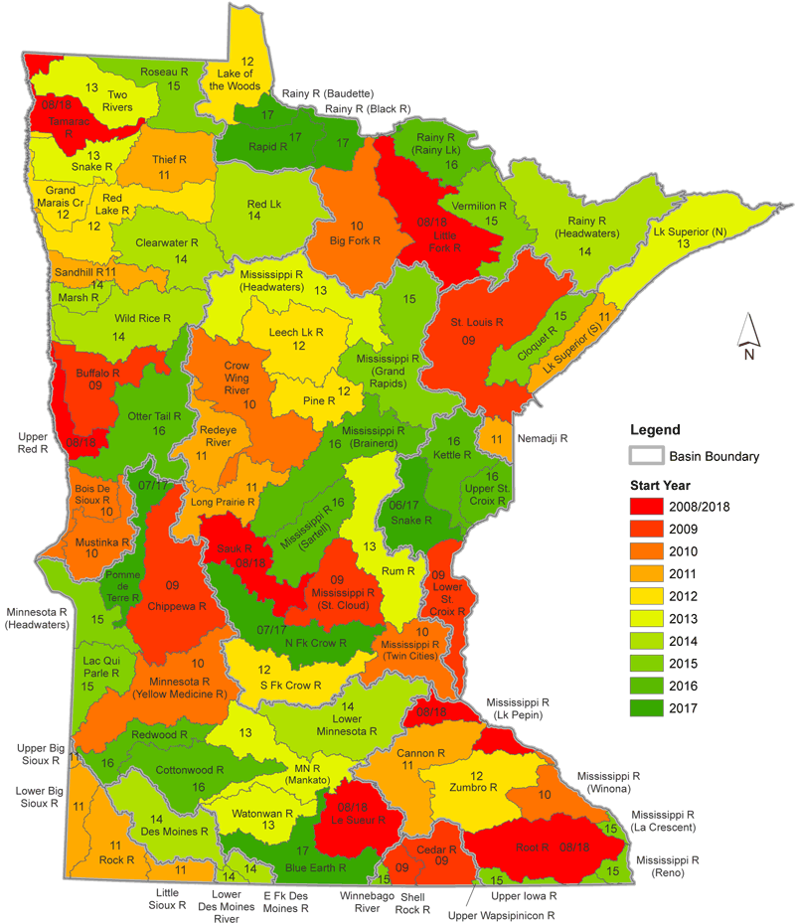

Slide 4
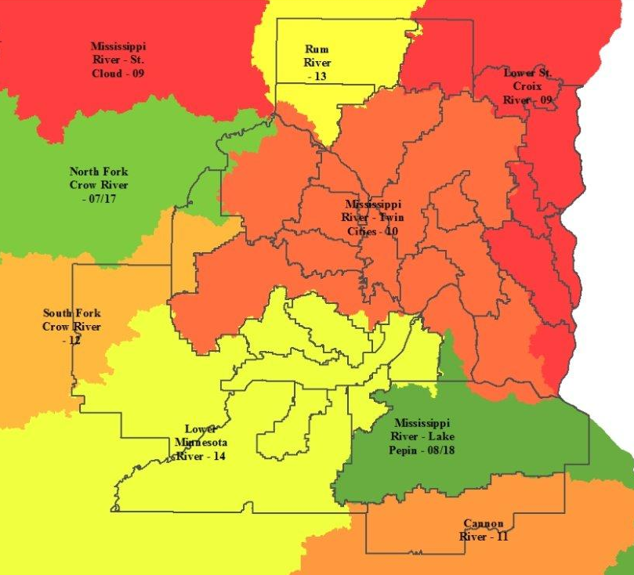

Slide 5
General wraps process:
Year 1 & 2: Monitoring – biological/chemistry
Year 3: Assessment (what’s impaired; what’s not); stressor ID for biologically-impaired streams
Year 4: TMDL development for:
Streams—turbidity/sediment, low oxygen, E. coli
Streams—biota, in which stressor = pollutant (sediment, nitrate, ???)
Lakes—phosphorus
Implementation prioritization + strategy development for restoration + protection → WRAPS Report
Year 5+: WDs/WMOs/LGUs incorporate WRAPS strategies into local water plans and make progress

