Slide 1

TMDL Implementation:
Now What?
West Metro Water Alliance
A Path to Clean Water – Understanding TMDLs and Watershed Planning
September 21, 2011
Diane Spector
Wenck Associates, Inc.

Slide 2
Outline
What are the implementation requirements?
Incorporating implementation plans into watershed and local water management
Paying for implementation activities
Adaptive management

Slide 3
Implementation Plans
Every TMDL must have an associated TMDL Implementation Plan approved by MPCA
The TMDL is one-time; the IP is a “living document”
The IP identifies specific policies, activities, projects, and programs; costs; timelines; and responsibilities

Slide 4
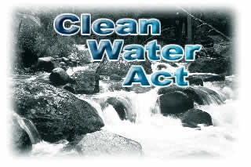
Implementation Requirements
Clean Water Act: carrot, not stick
No specific timeline requirements: “adequate progress”
MS4s have 18 months to incorporate implementation into their SWPPPs

Slide 5
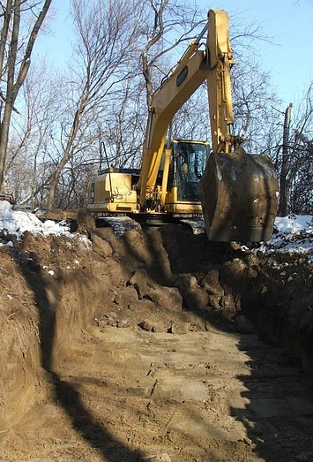
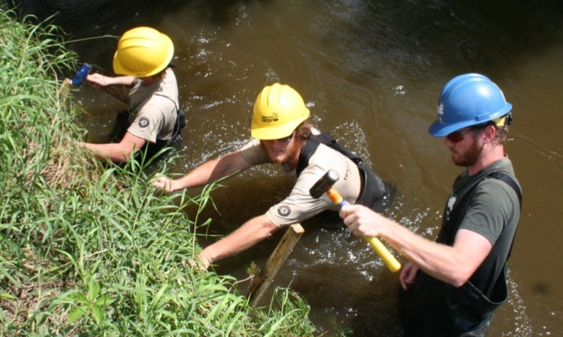
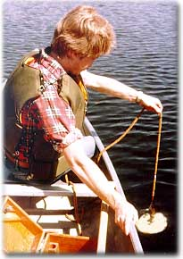
Implementation Activities
One-time or periodic
  Capital projects
  Maintenance projects
  Regulatory revisions
Ongoing
  Public projects
  Maintenance
  Education and outreach programs
  Monitoring
  Land use planning & development
  Retrofit BMPs

Slide 6
Bald Eagle Lake
Implementation Plan
Implementation Action | Responsible Party | Schedule | Estimated Cost | Estimated Phosphorus Removal
Coordination of Efforts | RCWD | Ongoing | Varies | N/A
Annual Report | RCWD, MS4s | Every year | $1,000 annually | N/A
Rules and Standards | RCWD | Ongoing | Varies | Varies
Maximize Reduction Through Development | RCWD, cities | Ongoing | Varies | Varies
Promote Better Site Design | RCWD, cities | Ongoing | Varies | Varies
Public Education | RCWD, cities, property owners | Ongoing | $2,500 annually | N/A
Cost Share Assistance | RCWD, cities | Ongoing | Current budget - $365,000 | Varies
Monitoring | RCWD, county | Ongoing | $20,000 annually | N/A
Watershed-External Load Reductions
Publicly Owned and Institutional Properties BMPs | Cities, counties property owners | 0-20 years | $2,500 - $25,000 each | Varies
Residential Rain Gardens | Property owners, RCWD | 0-20 years | $200 to $2,000 each; $75,600 - $189,000 to treat 15% of annual runoff | 41 pounds/year when 15% annual runoff is treated
Street and Highway Projects | Cities, counties | 0-20 years | Varies | Varies

Slide 7
Bald Eagle Lake
Implementation Plan
Implementation Action | Responsible Party | Schedule | Estimated Cost | Estimated Phosphorus Removal
Golf Course Management Plans | Golf course owners and managers, RCWD | 5-10 years | $20,000 each, $60,000 total | Goal is zero discharge
Improve Agricultural Management | SWCDs, property owners | 0-10 years | Varies | Varies
Complete Fish Lake TMDL | MPCA | 0-5 years | $25,000 | Load reductions to achieve the state standard of 40 µg/L
Protect High Value Wetlands | RCWD | Ongoing | Ongoing | N/A
Monitor Outlet Wetlands | RCWD | 0-10 years | $35,000 | N/A
CD 11 Channel Stabilization | Cities, RCWD | 0-5 years | $15,000 to $55,000 | Varies
Storm Sewer In-line Treatment | City of White Bear Lake, town of White Bear Lake | 0-10 years | $10,000 to $15,000 each | Varies
White Bear Lake Commercial Area BMPs | City of White Bear Lake | 0-5 years | $35,000 for assessment, $5-25,000 each for BMPs | 17 lbs/year for sweeping 5-10 lbs per site for BMPs
Pipe Outfalls In-line Treatment | Cities, RCWD | 5-10 years | $31,200 each + $3,000 O&M | <1 pound/year per device
Highway 61 Linear BMPs | Mn/DOT | 10+ years | Varies | Varies
Stillwater Street Reconstruction BMPs | White Bear Township | 0-5 years | $486,000 | 28 pounds/year
Regional Park Boat Landing BMP | Ramsey County | 0-10 years | $19,800 + $1,800 O & M | <1 pound/year
High School Parking Lot Runoff | School District, RCWD | 0-5 years | Varies | 14 pounds/year
Shoreline Restoration | Property owners | 0-20 years | $500,000 - $835,500 | N/A
Internal Load– Alum Treatment | RCWD | 0-5 years | $870,000 | 1,800 pounds/year
Aquatic Vegetation Management | Lake Association | 5-10 years | $20,000 annually | Varies

Slide 8
Implementation Planning
An Implementation Plan is not a resource plan, it’s a watershed plan
May need to rethink routine planning and maintenance activities
Will need to spend more money
May need additional planning or analysis to identify retrofit BMPs

Slide 9
Retrofitting Small BMPs
Planning for small BMPs
Detailed analysis by subwatershed
Identifies most cost-effective BMPs and locations on a neighborhood or site scale
Stormwater Retrofit Protocol-Metro Conservation Districts

Slide 11
Paying for Implementation
Grant Funds
  Clean Water Fund (BWSR)
  Section 319 (MPCA)
  Total Maximum Daily Load Grants (Public Facilities Authority)
Partnerships
Storm Drainage Districts
Storm Water Utilities
Special Assessments
County Tax Levy

Slide 12
Adaptive Management
Assess Progress
Design Strategy
Adaptive
Management
Evaluate
Implement
Monitor

Slide 13
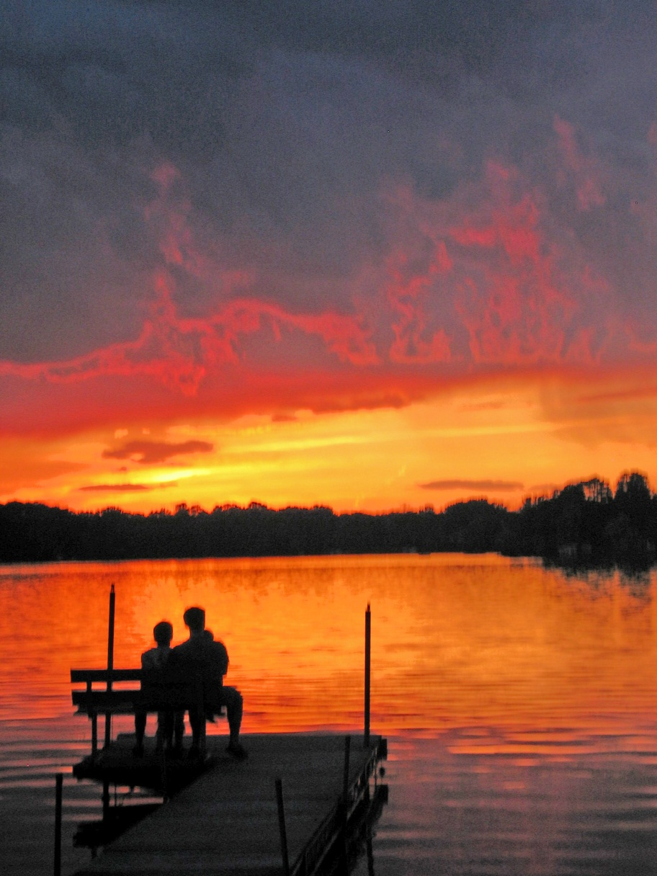

Thank you!

