Slide 1
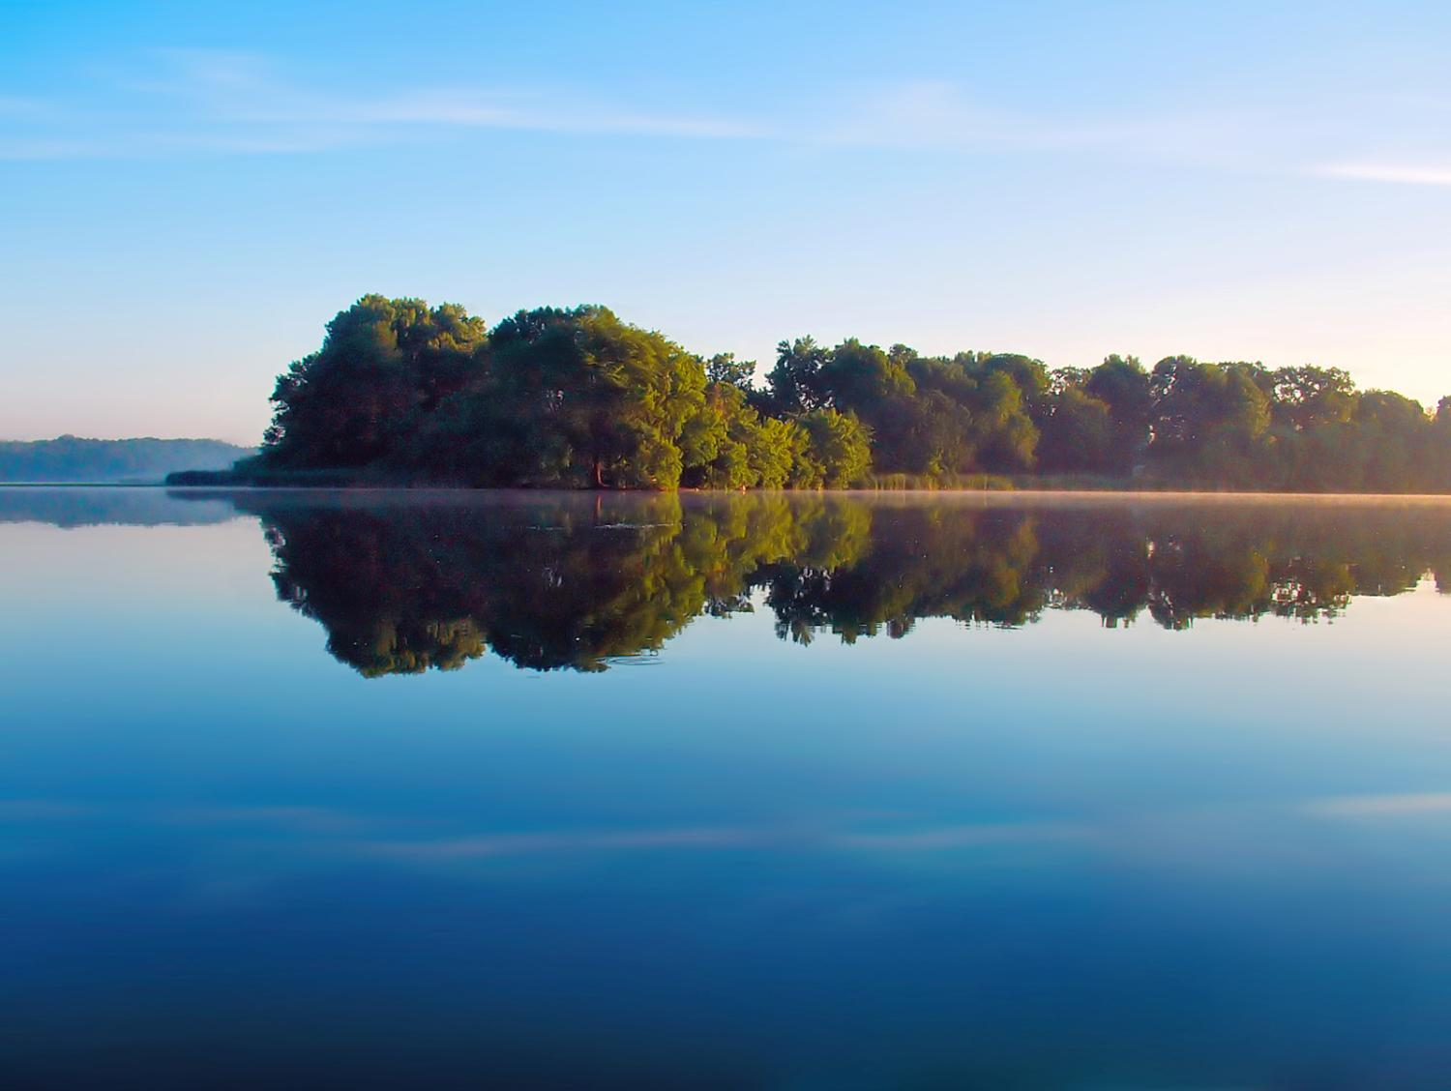
Environmental Education:
Another Piece of the Puzzle

Slide 2
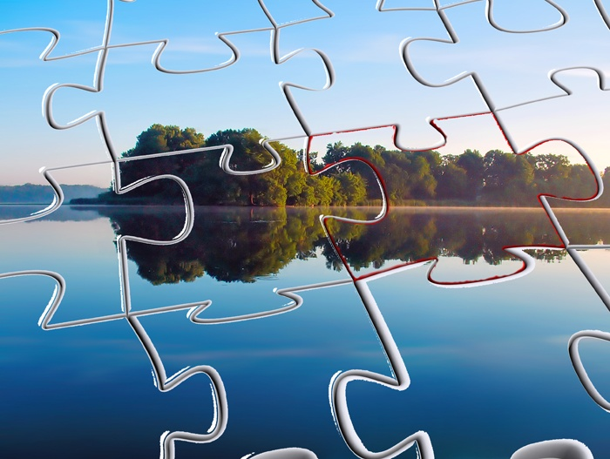
Projects & Practices
Regulations & Laws

Slide 4
People

Slide 5
Choices

Slide 6
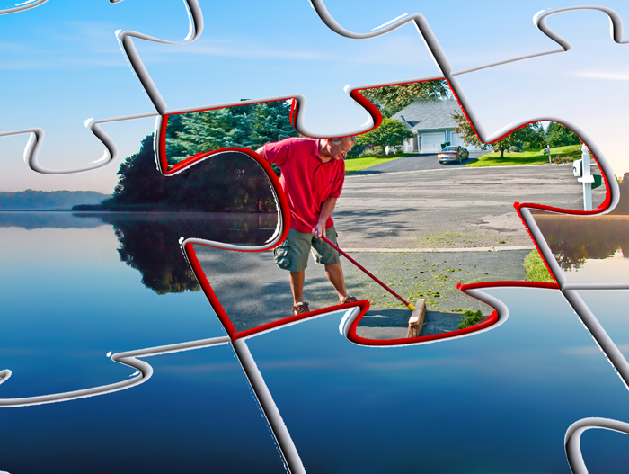
Actions

Slide 7
Support

Slide 8
Environmental Education

Slide 9
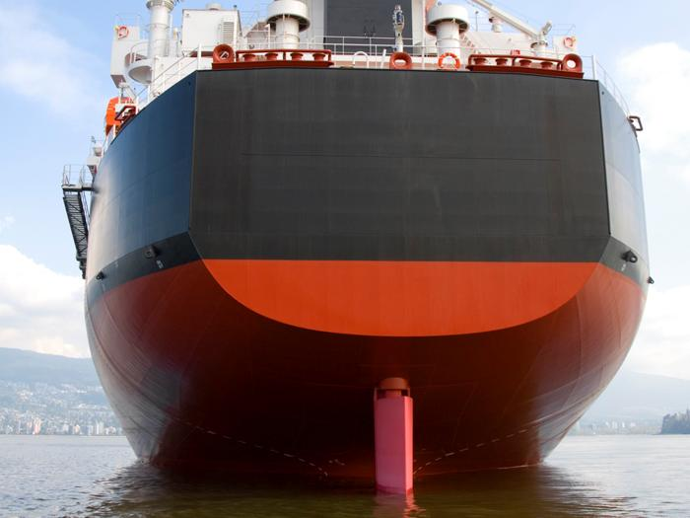
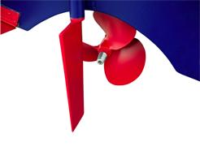

Slide 10
Inform
Persuade
Remind
Notes:
So let me first break it down into three types of information, and then I’ll share some of the things we have done, and are doing in Plymouth. The lines can overlap.

Slide 11
Inform
Phosphorus in fertilizer, yard waste and pet waste feeds algae in our lakes.
Stormwater runoff travels through storm sewers to lakes, streams and wetlands.
Everyone lives in a watershed.
Here are steps to reduce runoff.

Slide 12
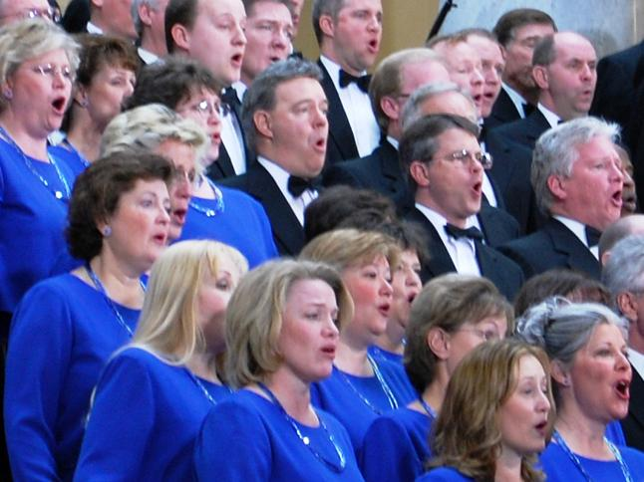

Slide 13
Notes:
Before I go any further with persuasion, I would like to share a little wisdom from a former neighbor.

Slide 14
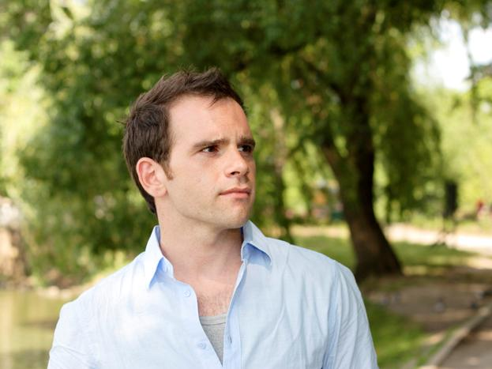

Slide 15
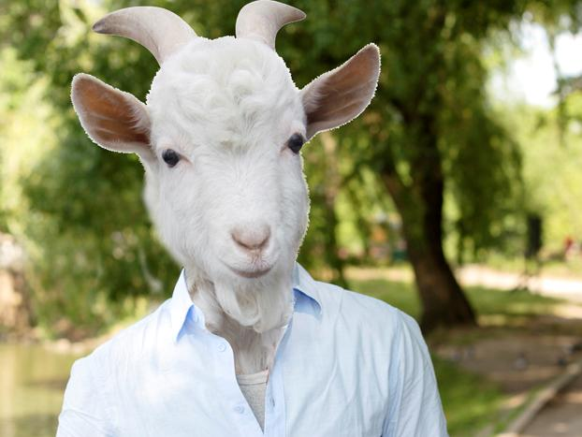
Notes:
Goats are not without humor, compassion, a concern for the environment. They just don’t want to be told what to do. It can be a good idea to make friends with a goat to check your message out with him/her.

Slide 16
Persuade
It’s the right thing to do.
Because my neighbor does.
Because I said so.
It’s easy.
It’s in my (my children’s, my community’s, my country’s) best interest

Slide 17
Remind
Repeat to be “heard.”
Remind to reinforce the message.
But don’t forget about the “goats” (i.e. don’t nag).
Notes:
Sometimes I get tired of my same-old message. Then I come across someone who seems to never have heard it.

Slide 18
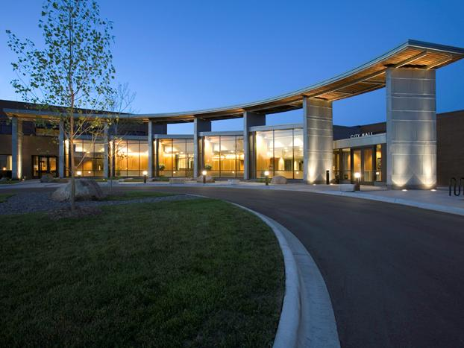
Plymouth Environmental Education
Notes:
We’ll never get anywhere if we don’t put out to sea.

Slide 19
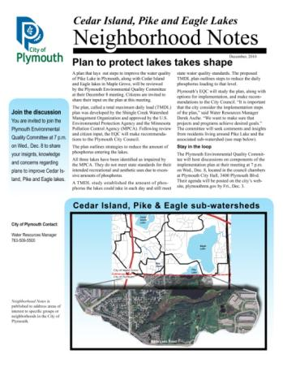
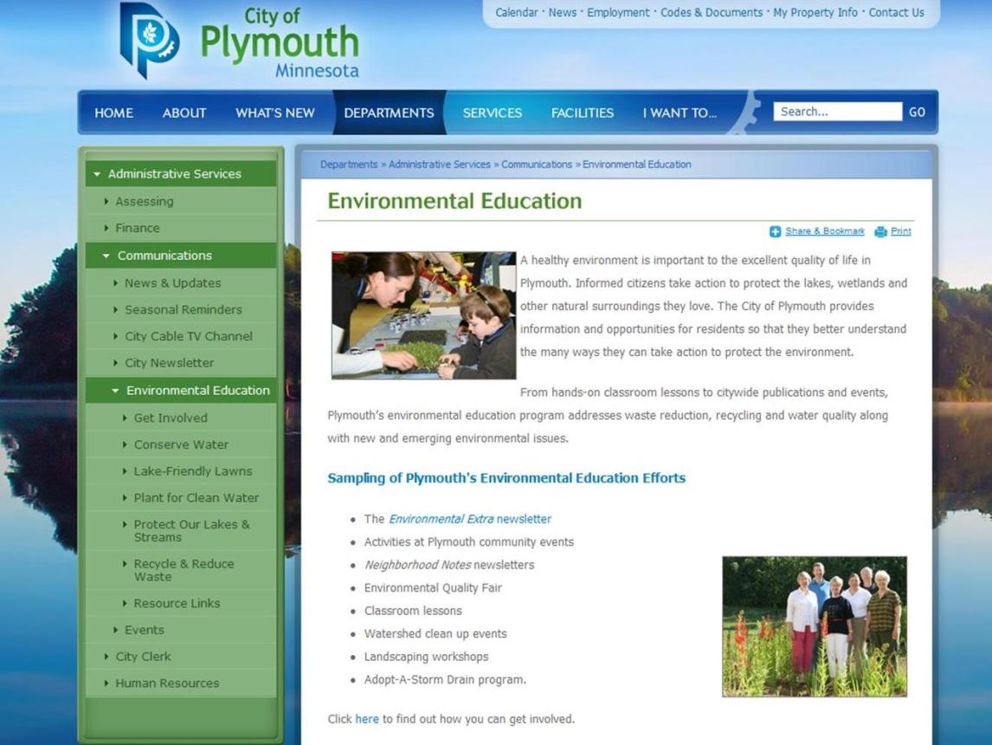
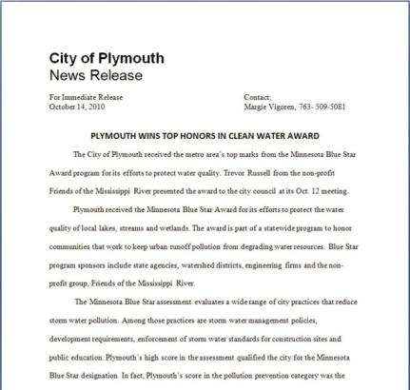
Publications/Publicity
Notes:
Environmental Extra, targeted mailings, newspapers, utility bill stuffers, brochures for events and new residents and the city website

Slide 20
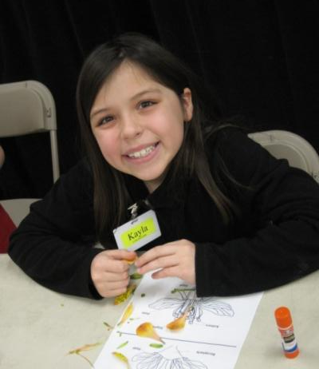
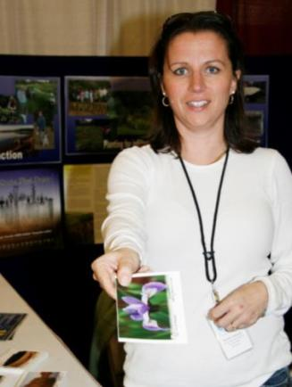
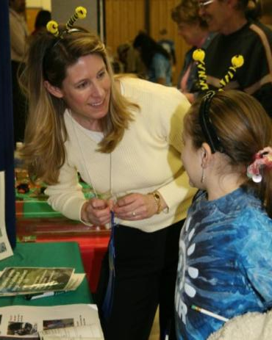
Events
Environmental Quality Fair
Yard & Garden Expo
Notes:
Environmental Quality Fair on Thurs., May 12 at Zachary Lane Elementary School
Y & G Expo on Fri., April 8 (6 to 9 p.m.) and Sat., April 9 (9 a.m. to 1 p.m.)
City Sampler – date to be determined
Music In Plymouth – Wed., June 29, 5 p.m. through fireworks
Invited to participate in Night to Unite open house.

Slide 21
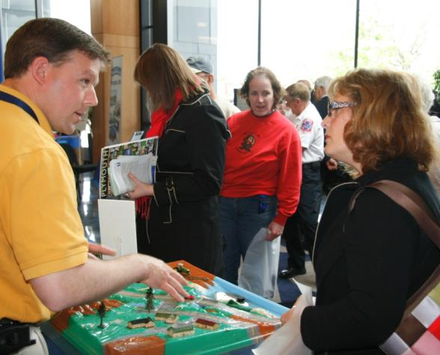
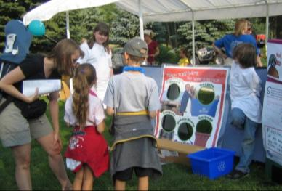
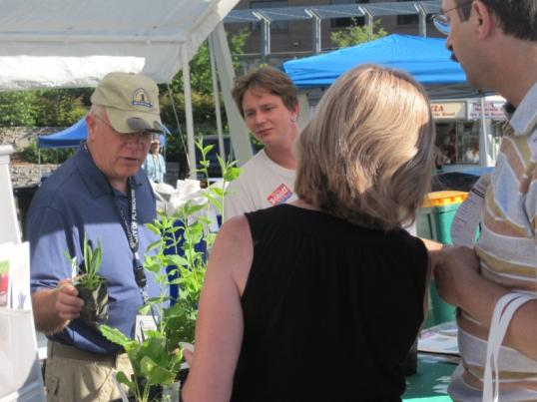
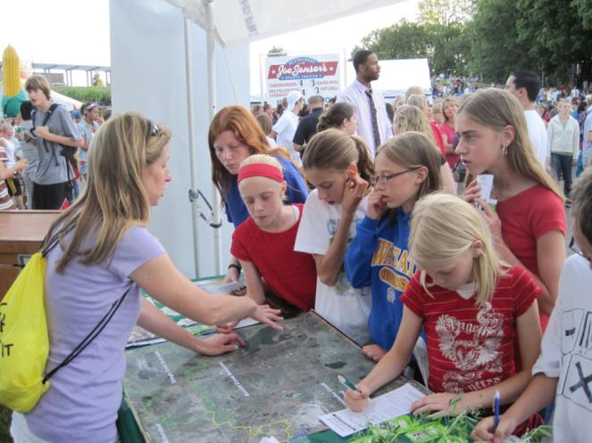
City Sampler
Music In Plymouth
Notes:
This is an invitation to all of you to join in on the Y & G Expo, EQFair and MIP

Slide 22
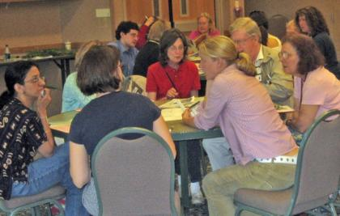
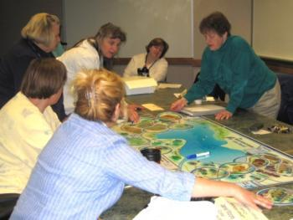
Workshops and presentations
Metro Blooms rain garden workshops
Workshops for councils, commissions and businesses.

Slide 23
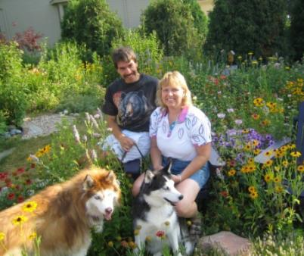
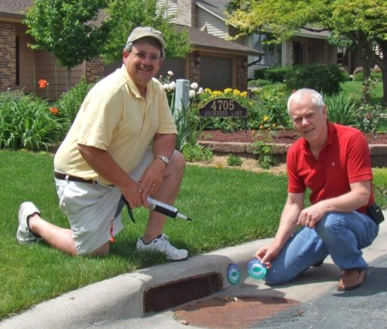
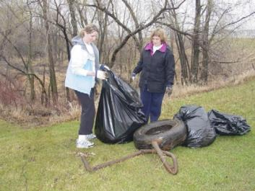
Citizen Participation
Environmental Champion awards
Adopt-A-Storm Drain
Shingle Creek Clean Up
Blue Thumb volunteers
Event volunteers

Slide 25
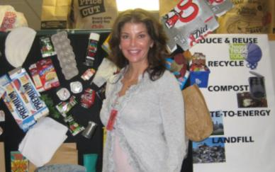
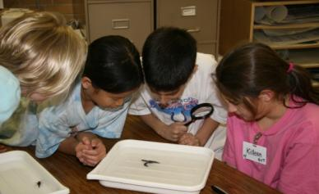
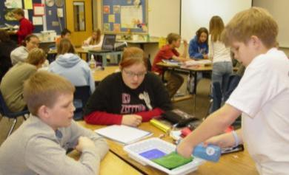
School Involvement
Arbor Day and recycling presentations
Environmental Quality Fair
curriculum offerings
Water quality presentations

Slide 26
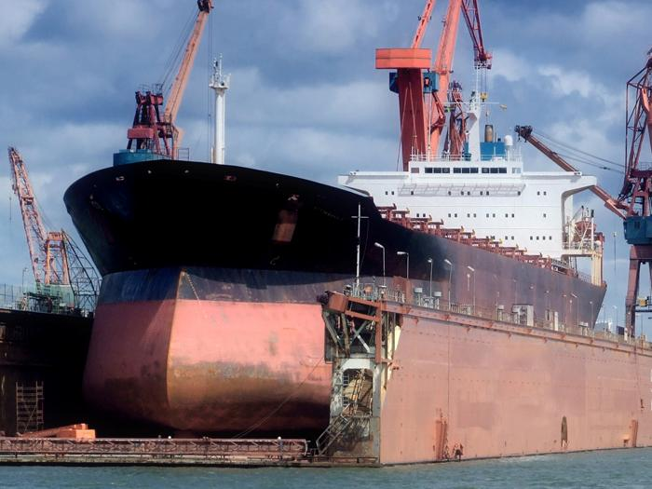
Notes:
Environmental education still feels like a small rudder on an ocean liner, but

Slide 27
Collaborations
Plymouth Forestry
Plymouth Parks & Recreation
Plymouth Recycling
Plymouth schools
Lake associations

Slide 28
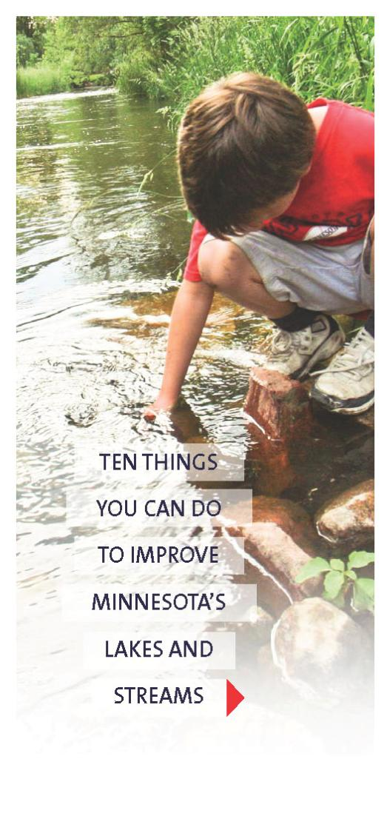
w m w a

Slide 29
Watershed Partneres’
CleanwaterMN
Notes:
CleanwaterMN campaign to continue

Slide 30
Blue Thumb
Watershed organizations
Hennepin County
Three Rivers Park District

Slide 31
Measuring Results

Slide 32
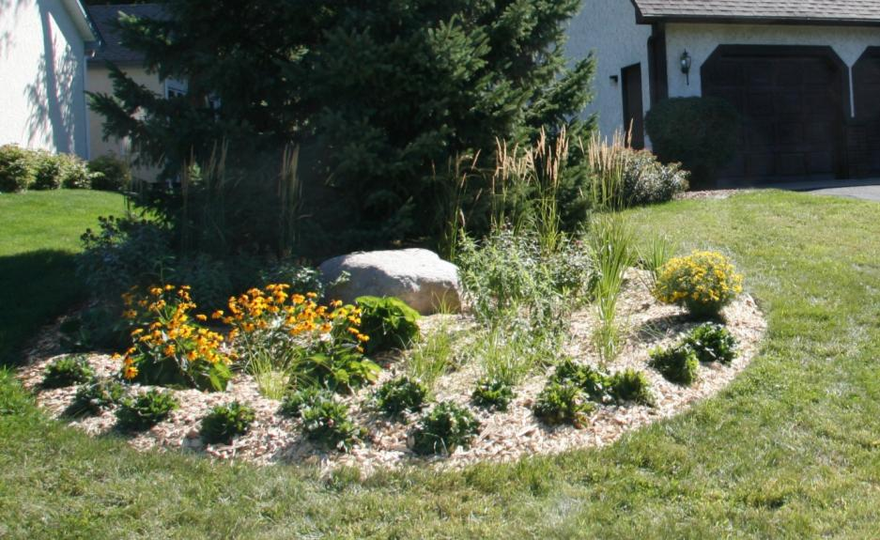
Landscape changes

Slide 33
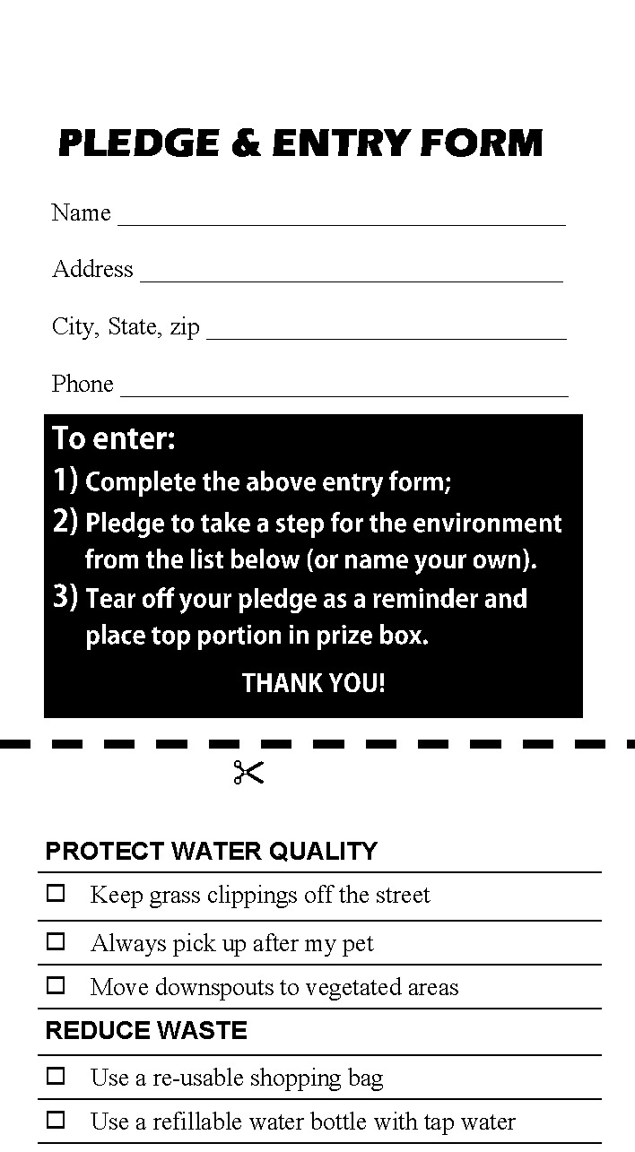
Pledges

Slide 34
Surveys
Lawn Care Practices
Approximately 80% of respondents have a yard. Actions reported:

Slide 35
Environmental issue facing Hennepin County of greatest importance

Slide 36
Clean Water Action Event Survey

Slide 38
Thank You!
Margie Vigoren,
Environmental Education Coordinator
City of Plymouth

