Slide 1
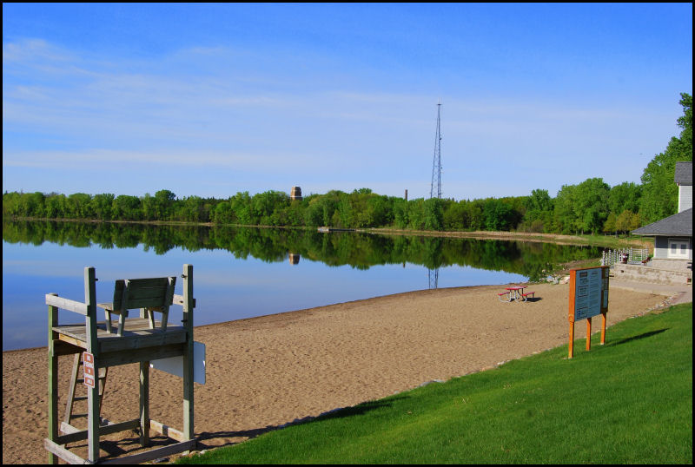
Protecting Non-Impaired Resources
West Metro Water Alliance
September 21, 2011
Greg Wilson, Barr Engineering Company

Slide 2
Outline
MPCA has transitioned from individual TMDL studies to a watershed approach
  Restoration of impaired waters to meet standards
  Increased emphasis on water quality protection of non-impaired resources
Updating Nondegradation rule to ensure that high quality waters do not deteriorate
Implications for watershed organizations and NPDES permitted Municipal Separate Storm Sewer Systems (MS4s)

Slide 3
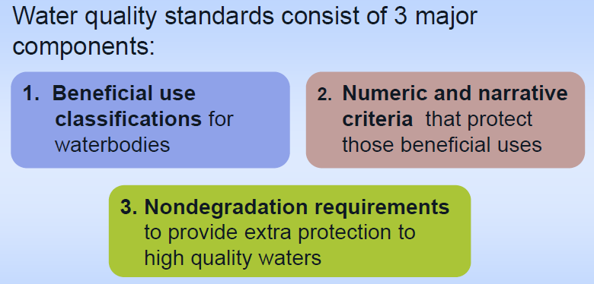
Water quality standards

Slide 4
Numeric water quality standards
Sets a specific concentration for a certain pollutant in water that will allow maintenance of beneficial uses
Use is a function or activity in a water that is supported by level of water quality/numeric criteria
  By default, all surface waters are protected as Class 2B (aquatic life and recreation)
  Other uses include drinking water (Class 1), trout waters Class 2A) and outstanding resource value waters (ORVWs)
These criteria are regulatory basis for management actions, including attainment decisions, TMDLs and NPDES permits

Slide 5
Numeric eutrophication standards
Ecoregion | TP | Chl-a | Secchi
(classification) | ppb ppb meters
NLF – Lake trout (Class 2A) | 12 | 3 | 4.8
NLF – Stream trout (Class 2A) | 20 | 6 | 2.5
NLF – Aquatic Rec. Use (Class 2B) | 30 | 9 | 2.0
CHF – Stream trout (2A) | 20 | 6 | 2.5
CHF – Aquatic Rec. Use (2B) | 40 | 14 | 1.4
CHF – Aquatic Rec. Use (2B) Shallow lakes | 60 | 20 | 1.0
WCP/NGP – Aquatic Rec. Use (2B) | 65 | 22 | 0.9
WCP/NGP – Aquatic Rec. Use (2B) Shallow lakes | 90 | 30 | 0.7

Slide 6
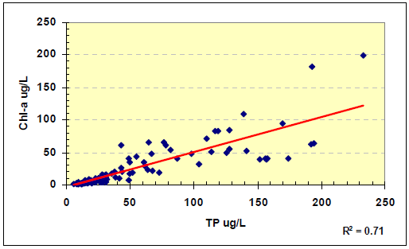
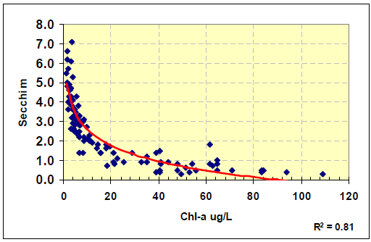
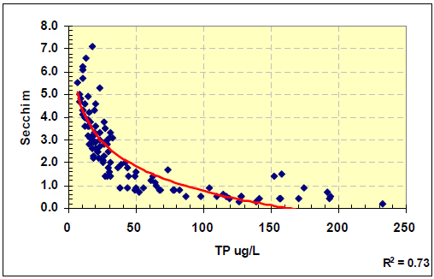
Benefits of protecting high quality waters

Slide 7
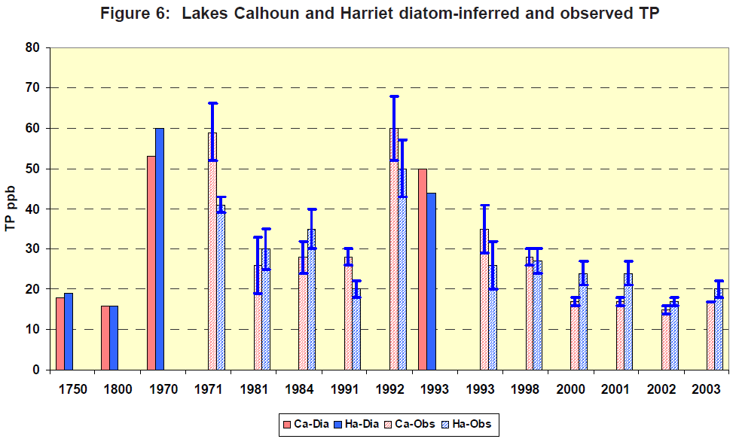
What level of protection is warranted?

Slide 8
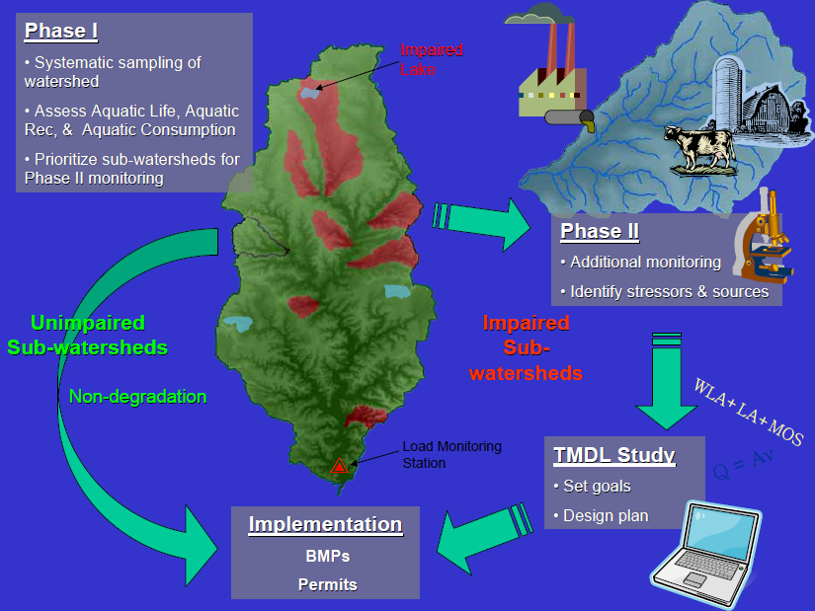
Watershed approach

Slide 9
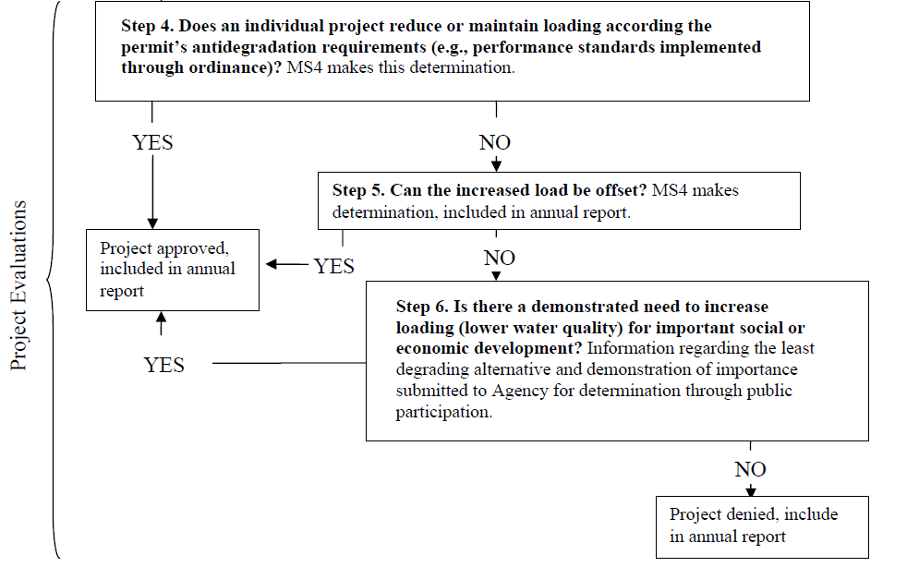
Nondegradation process for general permit

Slide 10
Implications of Nondegradation for watersheds and draft MS4 permit
Requirements for volume, rate, TSS and phosphorus loading
  No increased loadings w/ five options for demonstrating compliance for new development
  Net reduction in volume and pollutant loadings for redevelopments
  Existing peak rates for 1, 2, 10 and 100-year, 24-hr events
Limitations for infiltration (off ramps/options)
Mitigation requirements
  For TSS & TP elsewhere in watershed
Notes:
a) Areas of predominately Hydrologic Soil Group D (clay) soils
b) Areas within 1,000 feet up-gradient, or 100 feet down-gradient
of active karst features
c) Areas within a Drinking Water Supply Management Area
(DWSMA) as defined in Minn. R. 4720.5100, subp. 13
d) Areas where soil infiltration rates are more than 8.3 inches per
Hour
a) Areas where industrial facilities are not authorized to infiltrate
industrial stormwater under an NPDES Industrial Stormwater
Permit issued by the Agency
b) Areas where vehicle fueling and maintenance occur
c) Areas with less than three (3) feet of separation distance from
the bottom of the infiltration system to the elevation of the
seasonally saturated soils or the top of bedrock
d) Areas where high levels of contaminants (as defined by the
Agency) exist in the soil through which infiltration will occur

Slide 11
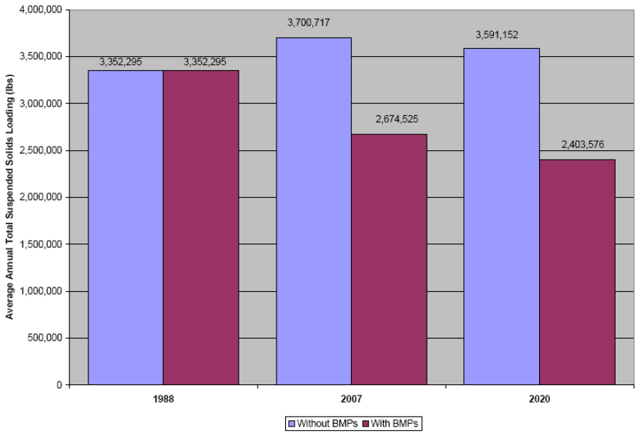
Implications of Nondegradation for watersheds and draft MS4 permit

Slide 12
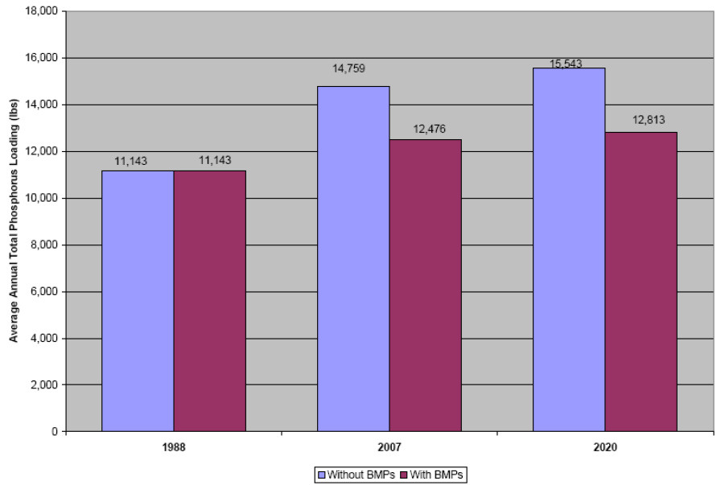
Implications of Nondegradation for watersheds and draft MS4 permit

Slide 13
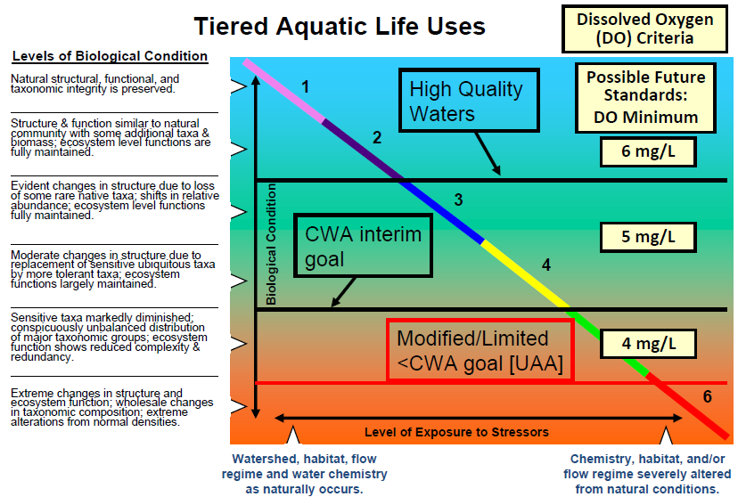
Implications of Nondegradation for watersheds and draft MS4 permit

Slide 14
Implications of Nondegradation for watersheds and draft MS4 permit
Relative to 1988 baseline, it is likely that land use conversion in most watersheds have resulted in the following:
  Increased volumes, runoff rates and TP loadings, depending on BMP implementation
  TSS loading reductions would be expected, especially where detention BMPs were implemented
Flow-weighted mean concentrations should go down with BMP implementation
Receiving water monitoring and trend analysis is the true test of whether Nondegradation requirements are being met

Slide 15
Implications of Nondegradation for watersheds and draft MS4 permit

Slide 16
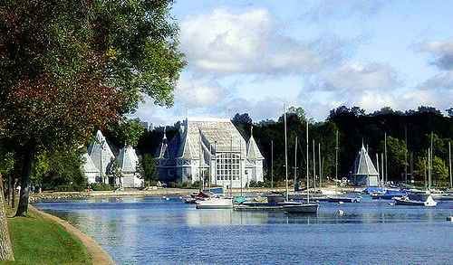
Thank you! Questions?
Greg Wilson, PE
Barr Engineering
952-832-2672
gwilson@barr.com

